Slide 1
Group A Presentation
Richard Badea, Rostyslav Kuznets, Kevin Alabi, King Diamonds Ebs

Slide 2
System Overview
Our application was based on an online shopping cart
Allowing the user to add, delete, and views items in a virtual shopping cart
Lastly it allows the user to purchase their items
2026
Rostyslav Kuznets

Slide 3
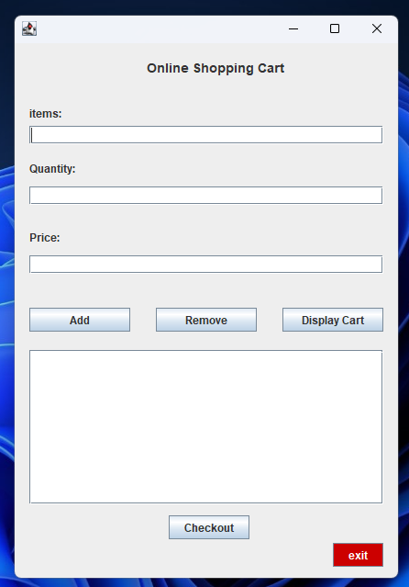
Demonstration of prototype
The user adds the item(s) they wish to purchase.
The GUI responds back through the TextArea
The details are stored in a .dat file
2026
Richard Badea

Slide 4
Challenges faced
Some challenges we faced were,
Handling invalid input
Fixing the remove button logic
Working on GitHub as a team.
Kevin Alabi

Slide 5
Scrum application
Product roles
Sprint meetings
Scaling

Slide 6
Thanks For Watching
Richard Badea (x24378823)
Rostyslav Kuznets (x24326776)
Kevin Alabi (x23382521)
King Diamonds Ebs (x22387341)
2026
Group A

Slide 7
Appropriate Links
GitHub-https://github.com/X24378823/SE-Project-Repo
Teams-

